Slide 1
Chapter 26

Slide 2
Objectives

Slide 3
Deploying a Windows Forms application: Option 1: XCopy deployment

Slide 4
Option 2: ClickOnce

Slide 5
Option 3: Setup program

Slide 6
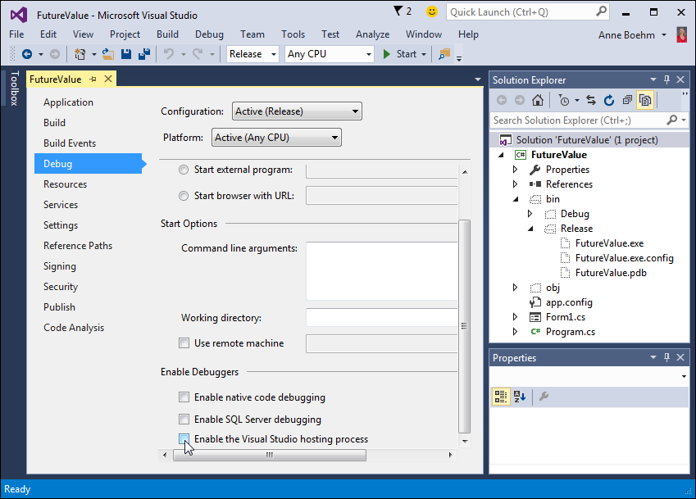
The Debug page of the Project Properties window

Slide 7
A procedure for using XCopy deployment

Slide 8
An example of the XCopy command

Slide 9
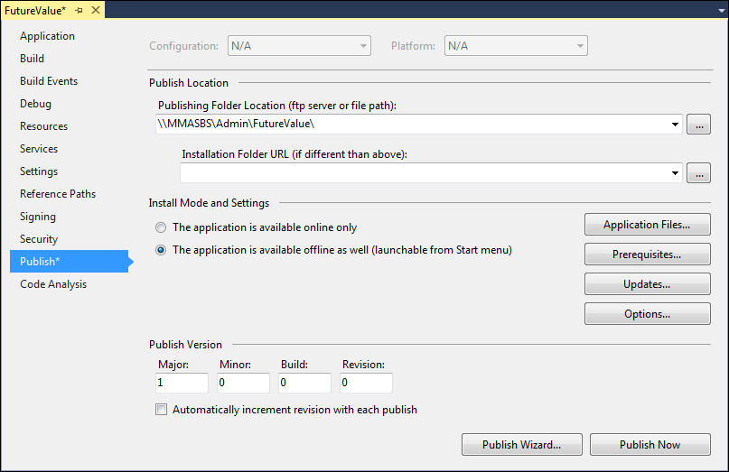
The Publish page of the Project Properties window

Slide 10
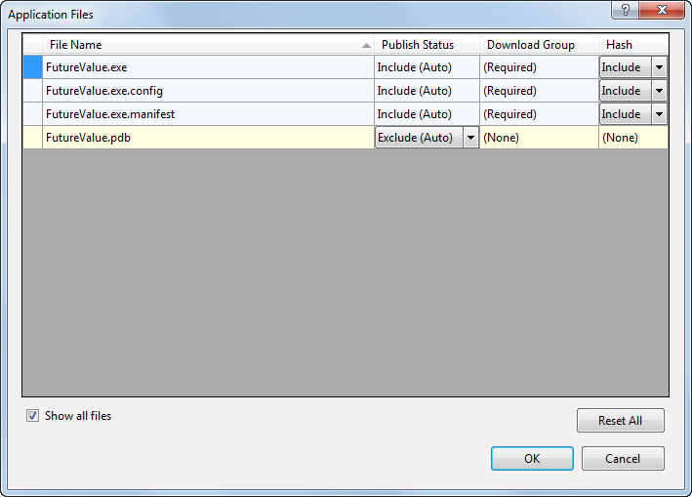
The Application Files dialog box

Slide 11
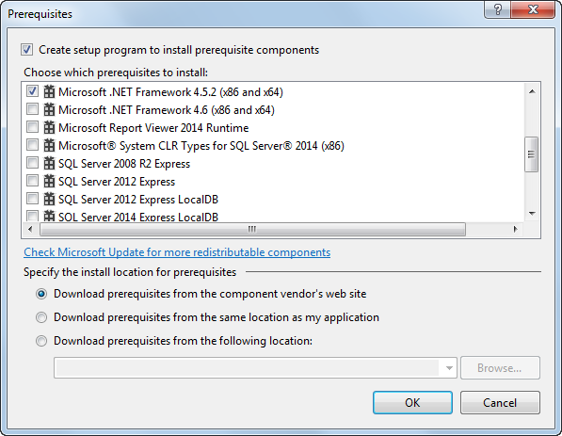
The Prerequisites dialog box

Slide 12
How to add the SQL Server 2014 Express LocalDB prerequisites

Slide 13
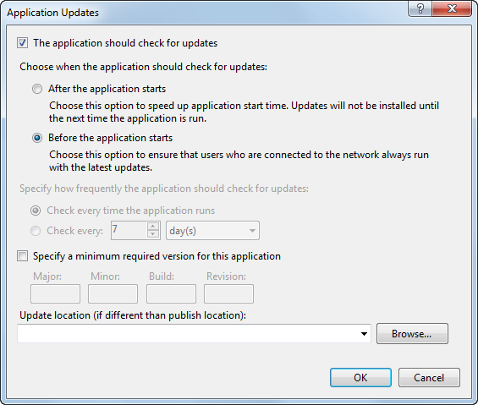
The Application Updates dialog box

Slide 14
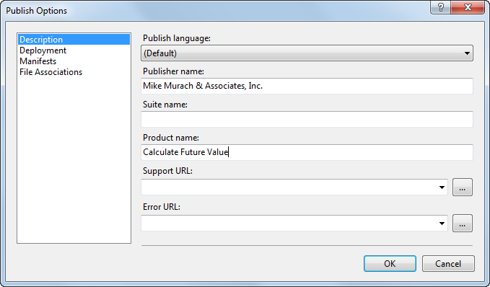
The Publish Options dialog box: Description page

Slide 15
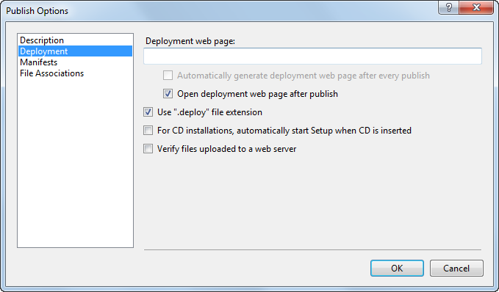
The Publish Options dialog box: Deployment page

Slide 16
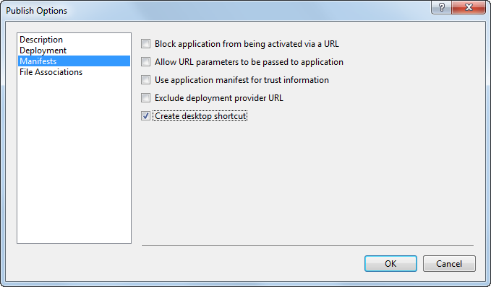
The Publish Options dialog box: Manifests page

Slide 17
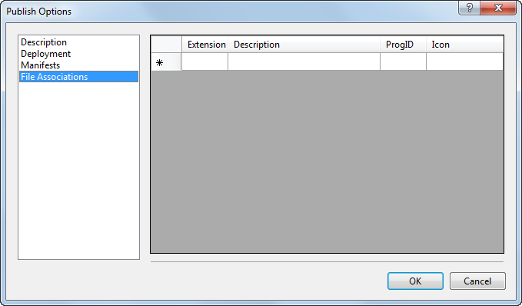
The Publish Options dialog box: File Associations page

Slide 18
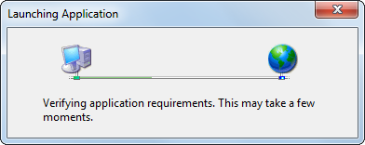
The dialog box that’s display when an application checks for prerequisites

Slide 19
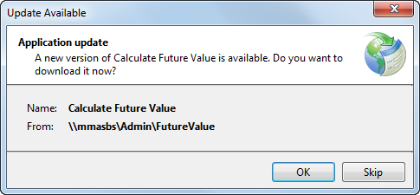
The dialog box that’s displayed if an update is available

Slide 20
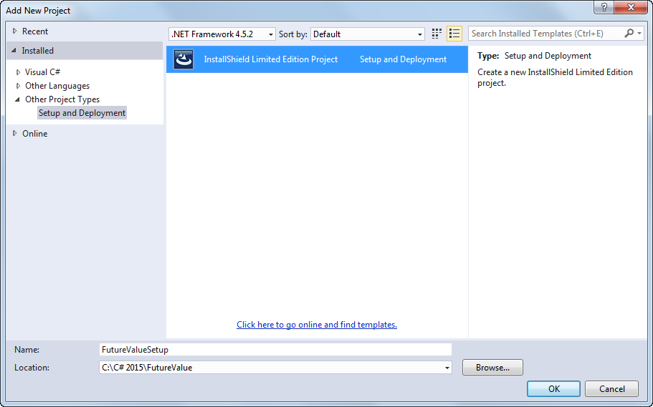
The Add New Project dialog box for an InstallShield project

Slide 21
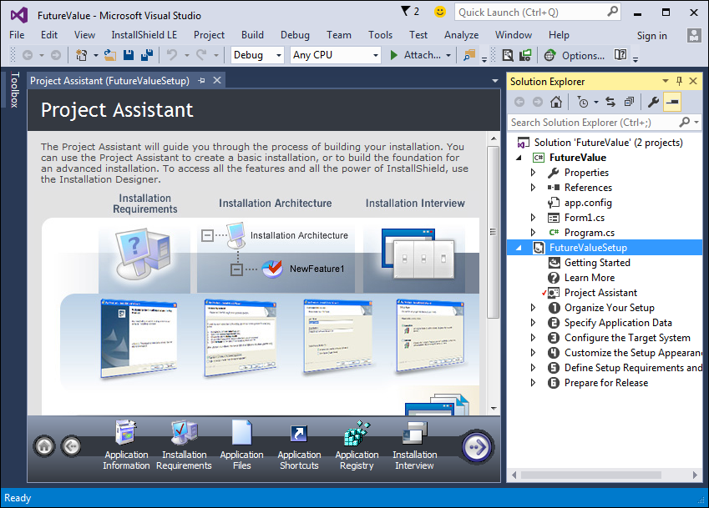
The InstallShield Project Assistant

Slide 22
The six pages of the Project Assistant

Slide 23
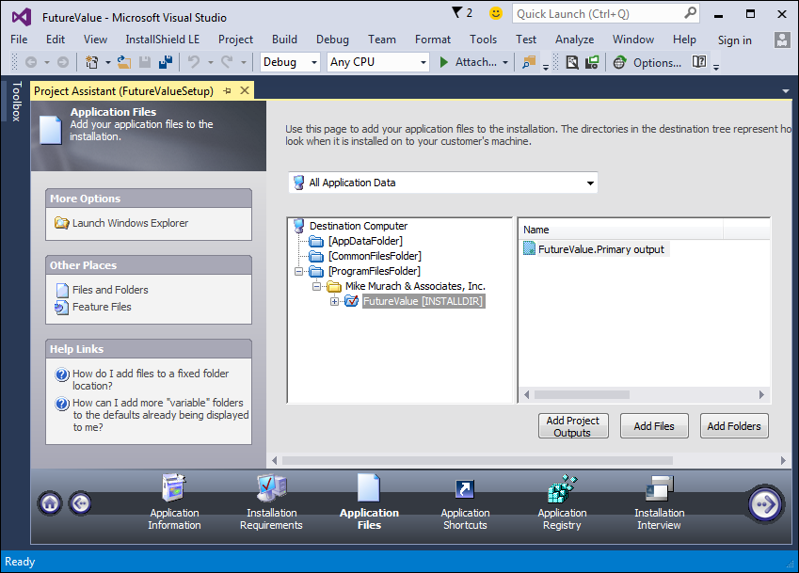
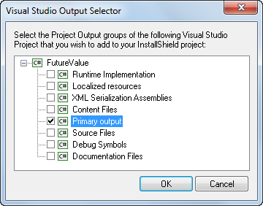
The Application Files page of the Project Assistant

Slide 24
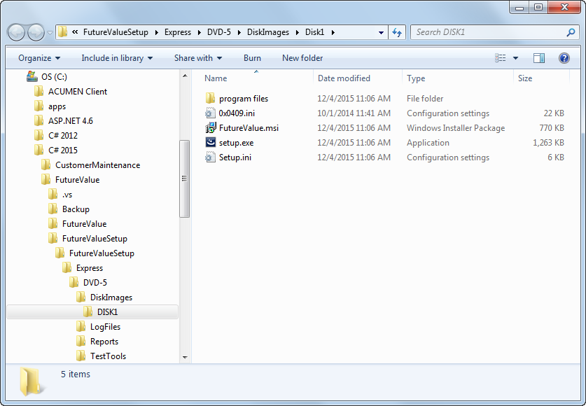
The installation file for the Future Value application

Slide 25
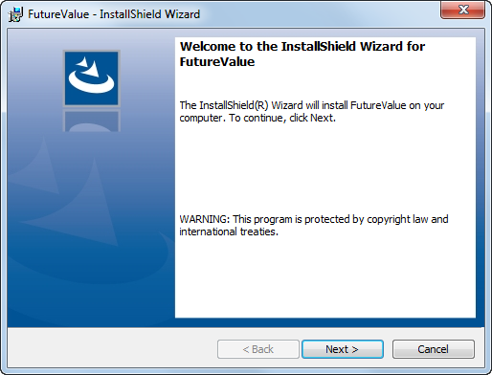
The Welcome step of the InstallShield Wizard

Slide 26
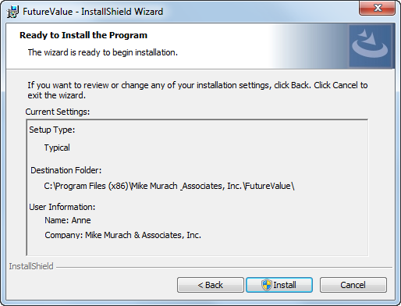
The Ready to Install step of the InstallShield Wizard

Slide 27
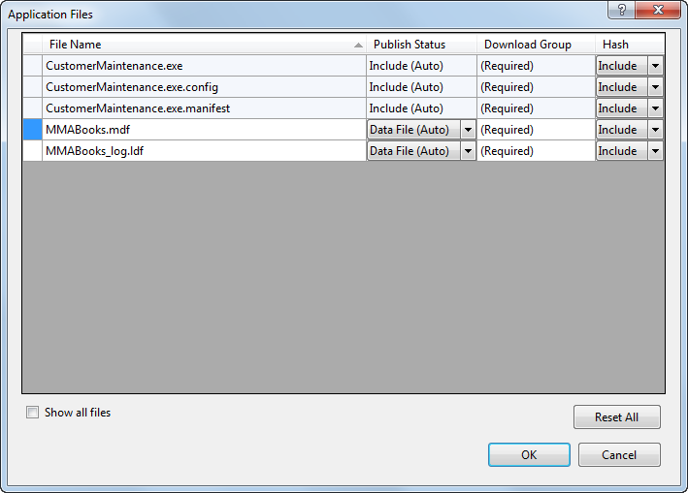
ClickOnce: The Application Files dialog box for a project that contains a database file

Slide 28
The connection string for a database that’s on a network server

Slide 29
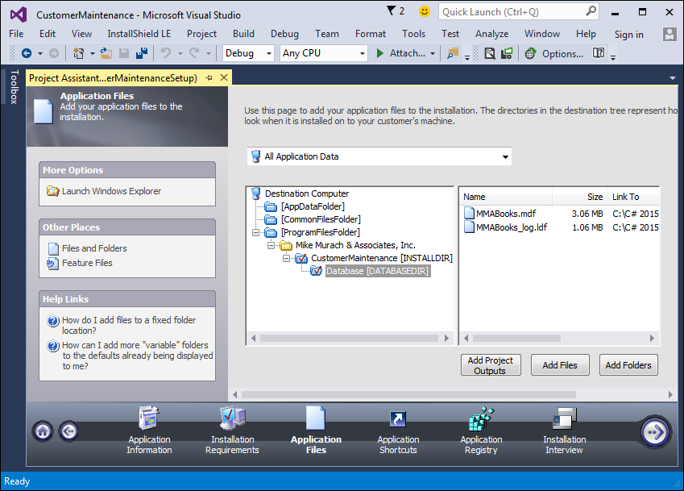
InstallShield project: an application with a database

Slide 30
The connection string for the application

